Slide 1

Using GPT API Models as Second Screeners of Titles and Abstracts in High-Quality Systematic Reviews
Mikkel Vembye, PhD
The Danish Center for Social Science Research, VIVE.
SRMA SIG, 2024.11.15
Notes:
Mention that the main goal of the presentation is to give a practical sense of this new screening approach.

Slide 2
Main goals of the presentation
1) To give you with a practical understanding of title and abstract screening using GPT API models.
2) To give you an impression of how relatively simple and powerful this screening approach can be.
3) To show how you can quality assess such screenings.
Find all material from this presentation at: https://github.com/MikkelVembye/SRMA-SIG-presentation
Find the paper behind this presentation at: https://osf.io/yrhzm

Slide 3
Why use AI for screening in systematic reviews?
For Quality Reasons: To reduce human errors
Human screeners overlook relevant studies for various reasons. Therefore, state-of-the-art is to conduct human double-screening. However, this is costly and many research groups cannot afford double-screening.
Reviewers most often limit their database searches so that they yield a number of studies that has a manageable size for humans to screen. However, this increases the risk of overlooking relevant studies.
For Resource Reasons: To reduce human resources and speed up the review process
Screening large amounts of references slow the review process as it can take an unmanageable amount of time. In our Campbell reviews, we spend approximately 3–5 months on this process, and even more in our large reviews.
It is tedious, manual work that can be hard to finish.
Some reviews cannot be completed because they require screening of too large a number of references. This problem will only grow over time as the number of references in research databases increases.
Notes:
Overlooking relevant studies at this initial review stage can be consequential, leading to substantially biased results.
AI tools can accommodate both type of issues

Slide 4
What we have tested and developed
We have tested the use of OpenAI’s GPT (Generative Pre-trained Transformer) API (Application Programming Interface) models to screen titles and abstracts. As you will see in a moment, this is NOT the same as using ChatGPT!
Our results show that GPT API models perform at least on par with human screeners performances, even in very complex reviews with many inclusion criteria. I will come back to these results later in the presentation
To conduct this type of screening, we have developed the R package AIscreenR (Vembye, 2024)
So far, we have not yet encountered a case where we could not reliably use this method, meaning that they show screening behaviors at least on par with human screeners.
Based on this, we suggest that GPT API models can be used as full secondary screeners in state-of-the-art reviews (for further details, see Vembye, Christensen, Mølgaard, & Schytt, 2024).

Slide 5
Why use GPT API models and not just ChatGPT?
Avoids copy-paste procedures, and it is easier to bypass model hallucination.
Makes it easy to test differences between models, prompts, etc.
You can screen an incredibly large amount of references in a very short time. With a sufficiently powerful computer, you can screen up to 30,000 per minute.
Multiple identical screenings can be performed, and inclusion criteria can be built based on how many times a reference has been included across these screenings.
Using gpt-4o-mini is cheaper than subscribing to ChatGPT Plus. With one prompt, you can screen 25,000 references for 1.5 USD.
Research indicates that GPT API models are better suited for screening than ChatGPT (Alshami et al., 2023; Gargari et al., 2024; Guo et al., 2024; Issaiy et al., 2024; Khraisha et al., 2024; Syriani et al., 2024).

Slide 6

AIscreenR Demo
Link to the package vignette:
https://mikkelvembye.github.io/AIscreenR/articles/Using-GPT-API-Models-For-Screening.html
Link to R codes behind the presentation:
https://github.com/MikkelVembye/SRMA-SIG-presentation/blob/main/Example%20code.R

Slide 7
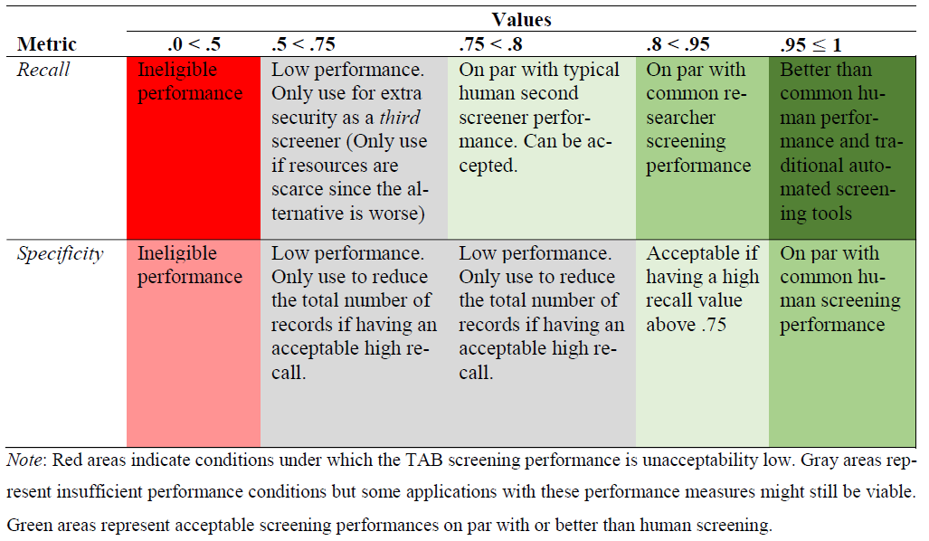
Quality assessment via benchmarking
We have developed a benchmark scheme based on our and our Campbell students' typical screening performances, which can be used to ensure the quality of title and abstract screenings.
In general, we recommend that GPT screenings should yield recalls above 75% to be usable in high-quality reviews.
Content-experts/researchers typically have recalls around 83%.
It is more challenging to set good guidelines for specificity. If recall is high, specificity matters less. It is simply an extra safeguard.

Slide 8
Why we consider benchmarking all-important
Guards against bad and biased screenings that are inferior to human screening.
It allows for context-specific assessments of the efficacy of using GPT API models as second screeners.
As we cannot control model developments, the benchmark scheme ensures that we can monitor model performances over time. Meaning that if we experience that a model suddenly cannot live up to our benchmarks we can stop using it.
Avoids the wild-west and ensures standardization of this screening approach.

Slide 9
How generalizable is this approach?
We have conducted three large-scale classification experiments with different levels of complexity in terms of the number of inclusion criteria. Herein we found that:
GPT API models can perform on par with or in some cases even better typical human second screeners in high-quality systematic reviews (Vembye et al., 2024). All models yield recalls above 80% in all of our experiments while showing high exclusion rate as well.
GPT-4 model can be rather over-inclusive n complex review settings.
The GPT-4 model outperforms the GPT-3.5-turbo model. We therefore recommend primarily using GPT-4 models for title and abstract screening.
Moreover, our newest results suggest that GPT-4o-mini, which is 200 times cheaper than GPT-4, can perform on par the GPT-4, when using 10 screenings. This is a game-changer in order to reduce the cost of this screening approach.

Slide 10

Limitations
Black-box models (notice: human screening most often represent black-box operation as well)
Off-the-shelf method that change over time.
It can be prompt sensitive
Potentially large environmental impact. However, this is not easy to fully assess (Tomlinson et al., 2024) but many people have concerns about this.
Advantages
Equal treatment of all titles and abstracts
It is fast
It is cheap
Can guard against human drifting.
Extra insurance that you have found all relevant records. Can also be used as a third screener.
Agnostic to data imbalance
It’s flexible

Slide 11
Future research
Test with local models such as the models from MistralAI. This would freeze the efficacy of this approach and increase its transparency.
Consider how to combine GPT screenings with traditional (semi)-automated screening tools such priority and classifier screening most efficiently.
Considered how can fine-tuning can support the reliability of the screening approach even further?
Implementation in standard review tools such as Meta-Reviewer, EPPI Reviewer, Covidence, etc.
Alternately, a shiny-app could be made to ease user-friendliness.

Slide 12
References
Alshami, A., Elsayed, M., Ali, E., Eltoukhy, A. E. E., & Zayed, T. (2023). Harnessing the power of ChatGPT for automating systematic review process: Methodology, case study, limitations, and future directions. Systems, 11(7), 351. https://doi.org/10.3390/systems11070351
Campbell Collaboration. (2023). Stepping up evidence synthesis: faster, cheaper and more useful. https://www.campbellcollaboration.org/news-and-events/news/stepping-up-evidence-synthesis.html
Gargari, O. K., Mahmoudi, M. H., Hajisafarali, M., & Samiee, R. (2024). Enhancing title and abstract screening for systematic reviews with GPT-3.5 turbo. BMJ Evidence-Based Medicine, 29(1), 69 LP – 70. https://doi.org/10.1136/bmjebm-2023-112678
Guo, E., Gupta, M., Deng, J., Park, Y.-J., Paget, M., & Naugler, C. (2024). Automated paper screening for clinical reviews using large language models: Data analysis study. J Med Internet Res, 26, e48996. https://doi.org/10.2196/48996
Issaiy, M., Ghanaati, H., Kolahi, S., Shakiba, M., Jalali, A. H., Zarei, D., Kazemian, S., Avanaki, M. A., & Firouznia, K. (2024). Methodological insights into ChatGPT’s screening performance in systematic reviews. BMC Medical Research Methodology, 24(1), 78. https://doi.org/10.1186/s12874-024-02203-8
Khraisha, Q., Put, S., Kappenberg, J., Warraitch, A., & Hadfield, K. (2024). Can large language models replace humans in systematic reviews? Evaluating GPT-4’s efficacy in screening and extracting data from peer-reviewed and grey literature in multiple languages. Research Synthesis Methods. https://doi.org/10.1002/jrsm.1715
Syriani, E., David, I., & Kumar, G. (2024). Screening articles for systematic reviews with ChatGPT. Journal of Computer Languages, 80, 101287. https://doi.org/10.1016/j.cola.2024.101287
Tomlinson, B., Black, R. W., Patterson, D. J., & Torrance, A. W. (2024). The carbon emissions of writing and illustrating are lower for AI than for humans. Scientific Reports, 14(1), 3732. https://doi.org/10.1038/s41598-024-54271-x
Vembye, M. H. (2024). AIscreenR: AI screening tools for systematic reviews. (0.1.0). CRAN. https://doi.org/10.32614/CRAN.package.AIscreenR
Vembye, M. H., Christensen, J., Mølgaard, A. B., & Schytt, F. L. W. (2024). GPT API Models Can Function as Highly Reliable Second Screeners of Titles and Abstracts in Systematic Reviews: A Proof of Concept and Common Guidelines. Open Science Framework. https://doi.org/10.31219/osf.io/yrhzm

Slide 13
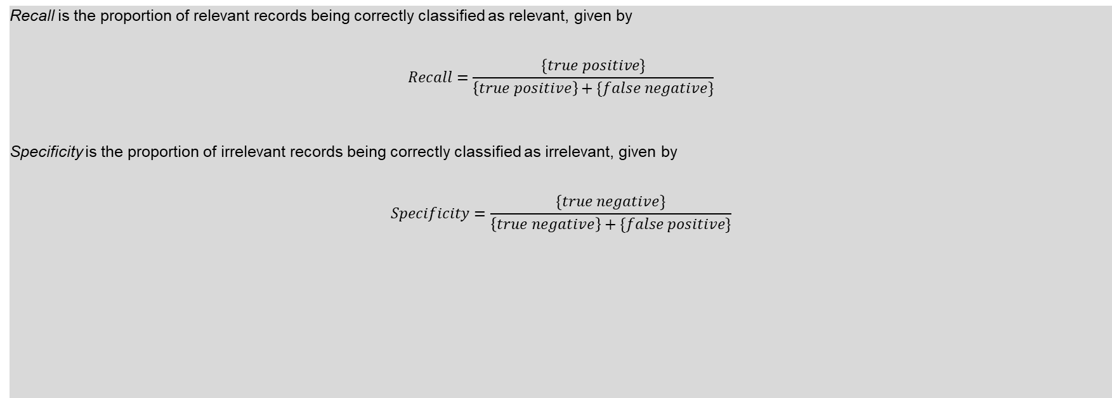

Appendix 1 - Assessment Measures
Recall is the proportion of relevant records being correctly classified as relevant, given by
$$Recall=\frac{\{true positive\}}{\left\{true positive\right\}+\{false negative\}}$$
Specificity is the proportion of irrelevant records being correctly classified as irrelevant, given by
$$Specificity=\frac{\{true negative\}}{\left\{true negative\right\}+\{false positive\}}$$

Slide 14
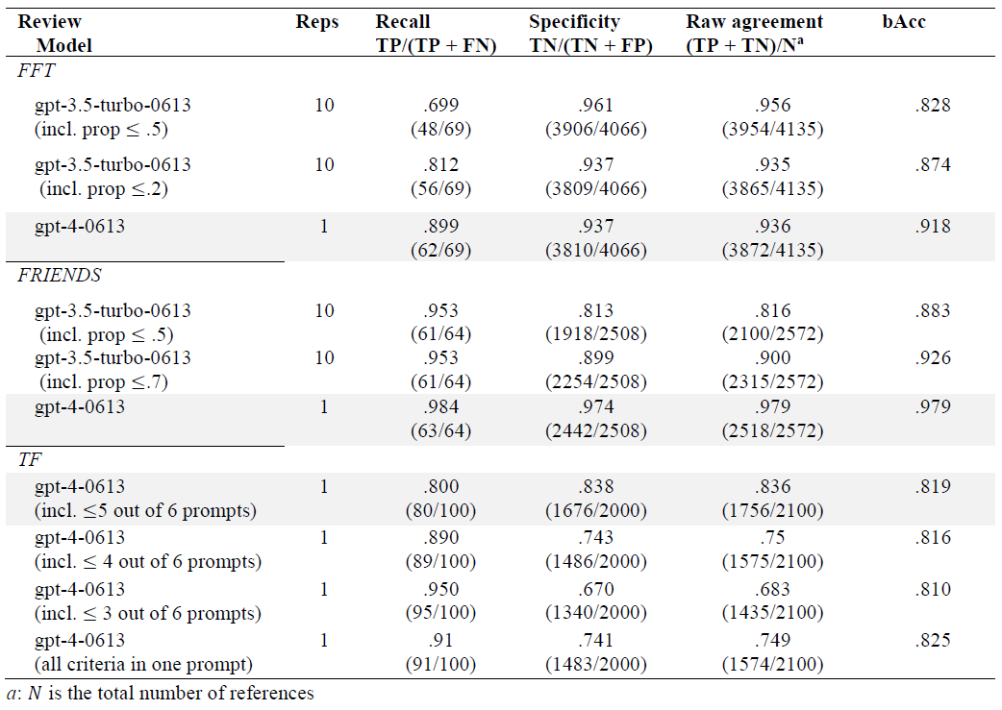
Appendix 2 – Numerical results

Slide 15
Appendix 3: What we also do: further standardization
Common guidelines for when it is (and when it is not) appropriate to use GPT API models for title and abstract screening in high-quality reviews. These guidelines are primarily based on the benchmark scheme.
A workflow for how to configure a reliable screening, including how to test and develop prompts. Hereto we introduce multiple-prompt screening, i.e., making one prompt per inclusion criteria.
According to Campbell Collaboration (2023) using AI in high-quality reviews requires:
(a) functioning tech [Outside our control]
(b) proof that it is functioning appropriately: [Our answer: Experiment results]
(c) the tech embodied in usable products: [Our answer: AIscreenR]
(d) agreed guidelines for appropriate use [Our answer: The use of benchmark schemes]
(e) training [Our answer: Assess the use with test data: Alternatively use fine-tuning]
(f) ongoing support [Our answer: Provide AIscreenR as an open-source software]
In our paper, we strive to accommodate requirements b to f.

Slide 16
Appendix 4: Other possibilities with AIscreenR
Can be combined with other (semi) automated screening tools such as priority and classifier screening.
Used to reduce the number of studies needed to be humanly double screened. This can be done by making too over-inclusive prompt on purpose.
Can be fine tuned to the specific review context

